Slide 1
Name : Sachin Prabhu P
NM.ID : au730321104043
RegNo : 730321104043
Dept : B.E-CSE
Year : 3rd-year
College : Builders Engineering College

Slide 2
Stock Market Prediction
This project aims to develop a system for predicting stock market behaviour using machine learning techniques
3/21/2024 Annual Review

Slide 3


AGENDA
Define Objectives.
Gather Data
Pre-process Data
Feature Engineering
Model Selection
3/21/2024 Annual Review

Slide 4

PROBLEM STATEMENT
The stock market is a complex system influenced by a multitude of factors, making it inherently difficult to predict future prices with perfect accuracy. Investors are constantly seeking methods to gain an edge and make informed decisions.
3/21/2024 Annual Review

Slide 5

PROJECT OVERVIEW
This project aims to develop a system for predicting stock market behaviour using historical data and machine learning techniques.
3/21/2024 Annual Review

Slide 6

WHO ARE THE END USERS?
There are several categories of end users who could benefit from a stock market prediction system, each with their own needs and risk tolerances:
Individual Investors
Financial Advisor
Hedge Funds And Algorithmic Traders
Financial Institutions And Research Firms
3/21/2024 Annual Review

Slide 7

YOUR SOLUTION AND ITS VALUE PROPOSITION
While I can’t claim to have a perfect solution for stock market prediction, I can propose a machine learning-based approach with a focus on transparency and risk mitigation:
My Solution: Multi-Model Ensemble
Explainable AI (XAI)
Risk Confidence Intervals
Scenario Modelling
3/21/2024 Annual Review

Slide 8

THE WOW IN YOUR SOLUTION
The “wow” factor in my proposed solution for stock market prediction lies in the combination of these three key elements:
Actionable Transparency: Most prediction systems are black boxes – you get an answer, but not the “why” behind it.
Quantified Uncertainty: Traditional predictions are often just point estimates, leaving users guessing about the potential range of outcomes
Scenario Planning for the Future: Looking beyond point-in-time predictions, this solution offers scenario modelling. Imagine being able to simulate the impact of various market events (e.g., interest rate hikes, recessions) on your portfolio
3/21/2024 Annual Review

Slide 9
MODELLING
Teams cam add wireframes
There are several machine learning models that can be effective for stock market prediction, each with its own strengths and weaknesses. Here’s a breakdown of some popular options: 1. Long Short-Term Memory (LSTM) Networks:
Strengths: LSTMs excel at handling time series data, making them well-suited for analysing historical stock prices and identifying patterns.
Weaknesses: LSTMs can be computationally expensive to train and require a significant amount of data.
2.Support Vector Machines (SVMs):
Strengths: SVMs are powerful for classification tasks and can be adapted for predicting whether a stock price will go up, down, or stay relatively stable.
Weaknesses: SVMs might not be ideal for predicting the exact magnitude of price movements.
3/21/2024 Annual Review

Slide 10
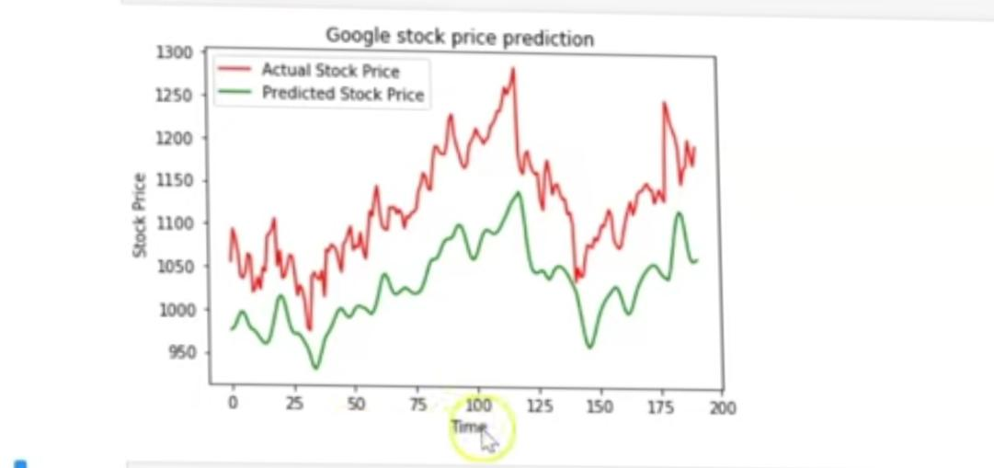
RESULTS
Demo Link
3/21/2024 Annual Review

